Slide 1
Constructor and Destructor function
It is common part of a program that requires initialization, specially long program.
In fact, when applied to real problems, virtually every object you create will require some sort initialization.
To address this situation, C++ allows a constructor function to be included in a class declaration.
A class constructor is called each time an object of that class is created.

Slide 2
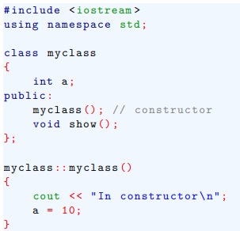
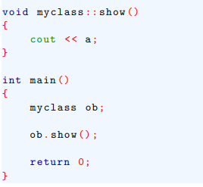
Constructor function
Thus, any initialization that needs to be performed on an object can be done automatically by constructor function.
A constructor function has same name as the class of which it is a part and has no return type.

Slide 3
Constructor function
For global objects, an object’s constructor is called once, when program first begins execution.
For local objects, the constructor is called each time the declaration statement is executed.

Slide 4
Destructor function
The complement of a constructor is destructor.
This function is called when an object is destroyed.
When you are working with an object, it is common to have to perform some actions when an object is destroyed.
For example, an object that allocates memory when it is created will want to free that memory when it is destroyed.

Slide 5
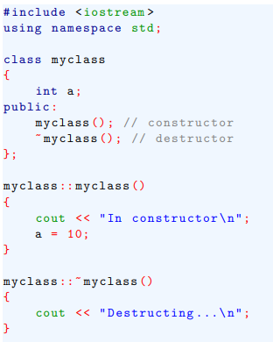
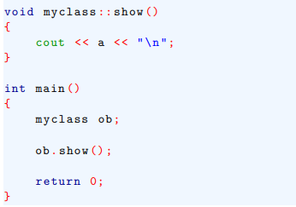
Destructor function
The name of destructor is the name of its class, preceded by a ~. For example-

Slide 6
Destructor function
A class’s destructor is called when an object is destroyed.
Local objects are destroyed when they go out of scope.
Global objects are destroyed when the program ends.

Slide 7
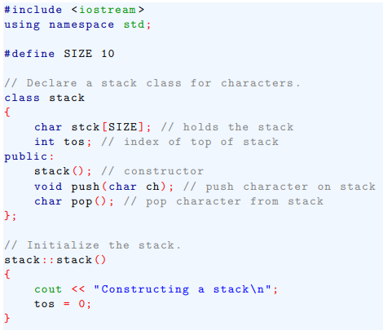
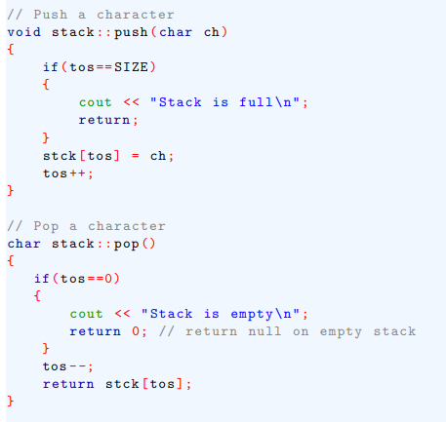
Destructor function
Here is an improved version of the stack class that uses a constructor that automatically initialize a stack object when it is created.

Slide 8

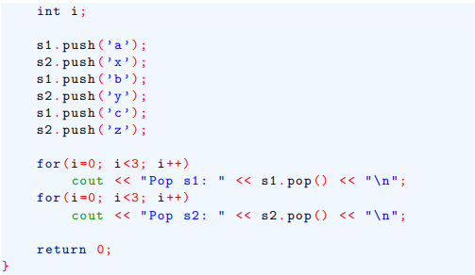
Destructor function

Slide 9
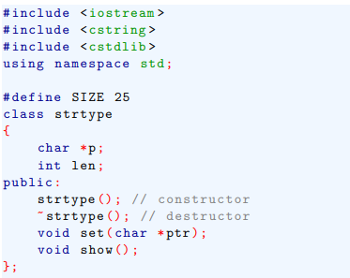
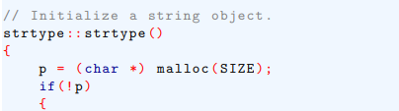
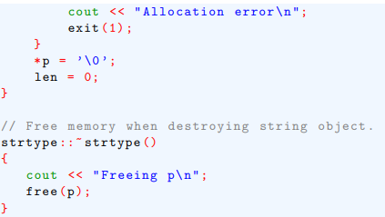
Destructor function
Here is an example that shows the need for both a constructor and a destructor function.

Slide 10
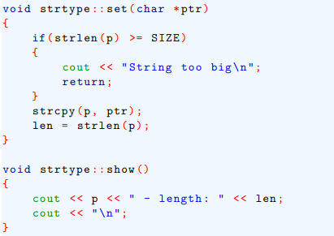
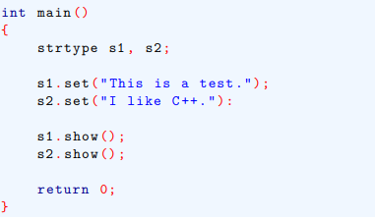
Destructor function

Slide 11
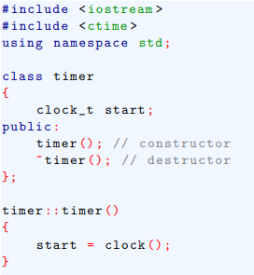
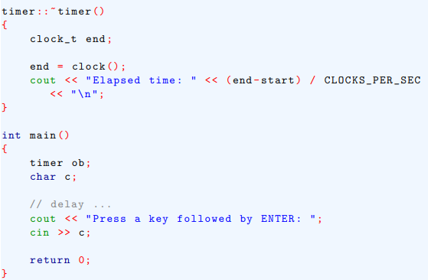
Destructor function
Another interesting example-

Slide 12
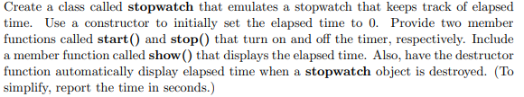
Destructor function
Home Work-

